Slide 1

Quality Alloy
Case Study
Chaitanya Varma Mudundi
Goutham Bommu
Hemanchal Joshi
Jasmeet Singh
Jiye Wang
Saranjyot Singh

Slide 2

Website Visits Overview
Total Visits
69,431
Unique Visits
65,287
New Visits
61,403
Total of 61,403 visitors accessed the Website.
Major source for the website traffic was through the referring sites.

Slide 3
Interest in the website
The website is generating interest but it remains nearly constant over the entire period of time.

Slide 4
Business Values
The interest in the website has no direct relation with the actual sales.

Slide 5
Business Values
Co-relation Co-efficient
0.05221 ≈ 0

Slide 6

Promotion Analysis
 | Visits | Unique Visits | Page views | Page/ Visit | Avg. Time on Site | Bounce Rate | %New Visits | New Visitors | %Unique Visits | Revenue | Profit | Lbs.Sold | Inquiries
Initial | 1,055 | 976 | 2,348 | 2.28 | 80 | 67% | 87% | 916 | 93% | 608,250 | 200,233 | 18,737 | 7
Pre-Promotion | 563 | 571 | 1,509 | 2.67 | 96 | 59% | 84% | 471 | 92% | 534,314 | 159,932 | 18,441 | 6
Promotion | 1,814 | 1,739 | 3,102 | 1.79 | 49 | 77% | 91% | 1,666 | 96% | 456,399 | 131,930 | 17,113 | 6
Post-Promotion | 857 | 801 | 1,868 | 2.18 | 70 | 66% | 86% | 740 | 93% | 371,728 | 111,046 | 14,578 | 5

Slide 7
Promotion Analysis
3,726
Effect of Traditional Promotion Period on Visits
Notes:
The Traditional promotions from mid december have driven the number of vistis to the website in the promotional period.The visitors reached to the highest in the first week of march to 3726

Slide 8
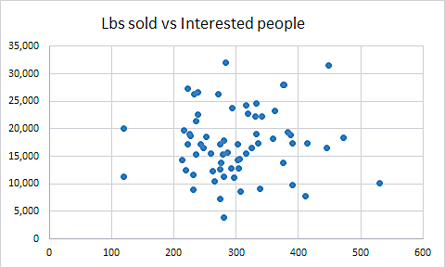
Promotion Analysis
Co-relation coeff = 0.05221
Co-relation coeff is very small and close to zero. So there is no impact on sales by the visits

Slide 9
Promotion Analysis
Notes:
The Bounce Visits is maximum in promotional period which indicates that even through the number of visits to the website has increased drastically in the promotional period most of them were users that were not interested in the website.

Slide 10
Promotion Analysis
Visits
Notes:
Even through the visits to the website have increased the sales where no way impacted by the promotions as the lbs sold has not increased during the promotional period rather it decreased a little bit when compared to pre-promotional and Initial periods.

Slide 11

Website Model
Total Visitors
61,403
Two Weeks
Time Selection
 | This Week | Last Week | Aug 9- Aug 15 | Add
Interested Visits | 294 | 281 | 263 | Hide
Bounce Rate | 61.92% | 63.79% | 66.33% | Hide
Avg Time on website | 72 | 70 | 69 | Hide
Notes:
When we were modeling the visits data, we tried to find out what the managers want to see straightly from the website analysis. The number of total visits is always the most important. It tells about how many potential customers this website reaches. And we provide a line graph to monitor the recent changes of weekly visits to measure the effectiveness of relevant online activities. Besides, there are two pie charts indicating the portion of different traffic sources and geographical distribution of visits respectively, providing a timely results of internet advertising strategies or geographically oriented promotions. The table below shows some key performance indicators based on a weekly basis. The interested visits and bounce rate can provide convincing data of whether the promotions reach the target customers in numerical and ratio aspects respectively. And average time spent on site can provide evidence to make assumptions of whether the information on the website is sufficient, concise or attractive.

Slide 12
Website Model
Total Visitors
61,403
Two Weeks
Time Selection
 | This Week | Last Week | Aug 9- Aug 15 | Add
Interested Visits | 294 | 281 | 263 | Show
Bounce Rate | 61.92% | 63.79% | 66.33% | Hide
Avg Time on website | 72 | 70 | 69 | Hide
Notes:
Moreover, there are several useful functions provided. Users of the website model can click here to add any of these KPI to the line graph above to make bi-variate or multi-variate comparisons.

Slide 13
Website Model
Total Visitors
61,403
2018 May - 2019 Aug
Time Selection
 | This Week | Last Week | Aug 9- Aug 15 | Add
Interested Visits | 294 | 281 | 263 | Show
Bounce Rate | 61.92% | 63.79% | 66.33% | Hide
Avg Time on website | 72 | 70 | 69 | Hide
Notes:
And by using the function of time selection, managers can easily observe the trend of these values in short or long time period, for example, the four periods around promotion.

Slide 14

Opportunities
Notes:
Just as I said, the analysis of web traffic can help with measuring more efficient and effective approaches of promotion. Undoubtedly, referring sites and search engines are the dominate entrances with the ratio of 56% and 30% respectively. And within referring sites, two google yellow pages make up 79% of visits, followed by a 11% of sedoparking.com.

Slide 15
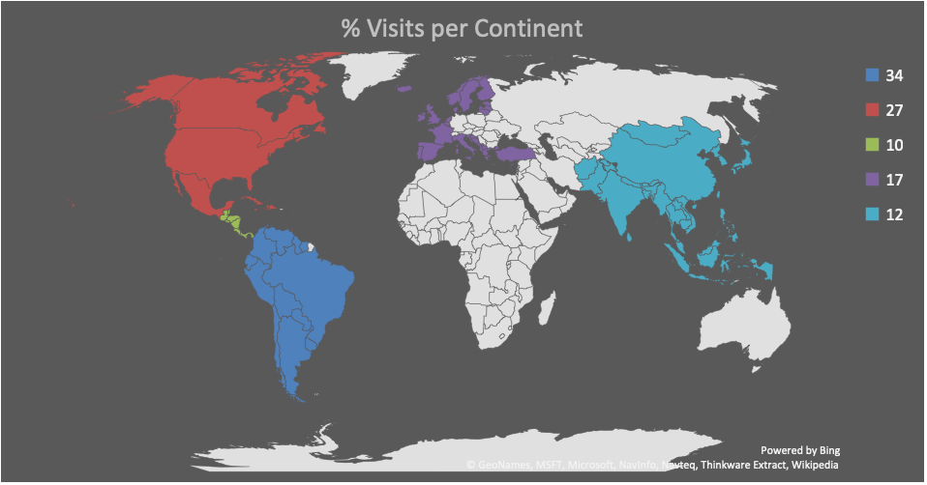
Opportunities
Visits Proportion per Geographical Region
Notes:
Then look at the sales, the stable clients from South, North and Central American contribute to 71% of the alloy sold. And sales in Europe and Asian occupy 17% and 12% respectively.

Slide 16

Opportunities
2,721
17,509
5,214
1,427
1,538
3,228
6,776
2,589
1,968
22,616
Notes:
With this graph we can see the number of regional sales more clearly. In South America and Asia where manufacturing business is booming, the sales are quite different as sales in Asian are even less than half of the sales in South America. So, there are more opportunities in Asian ares and we can find a market niche there. Taking all factors into consideration, I mean, including the fact that traditional promotion did lead to a huge web traffic. We should remain the brand visibility by posting website portals in major yellow pages and searching engines, and plan regional specific promotion strategies for Asia countries combining advertising in local yellow pages and search engines and direct mails to potential customers.

Slide 17
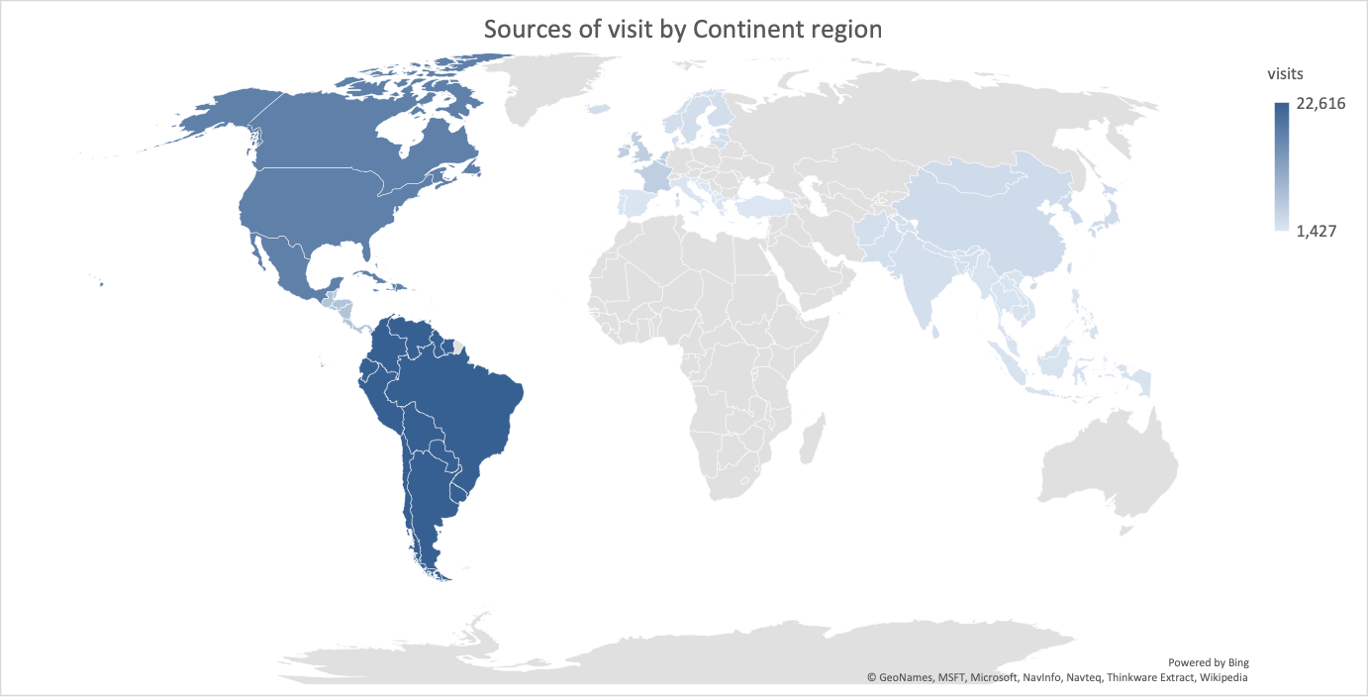

Slide 18
Website Overview
Total Unique Visits
Visits Over Time
Demographics

Slide 19
Business Values
Interests

Slide 20
Business Values
Interest over Sales

Slide 21
1

Slide 22
2.a. Promotion Analysis

Slide 23
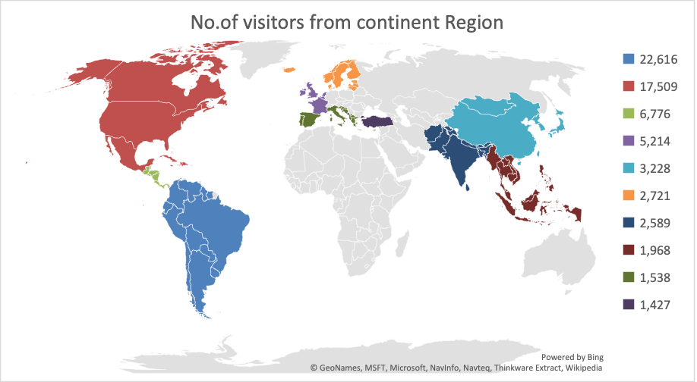

Slide 24
Sample Footer Text
4/6/19
24

Slide 25
2.b. Promotion Analysis

Slide 26
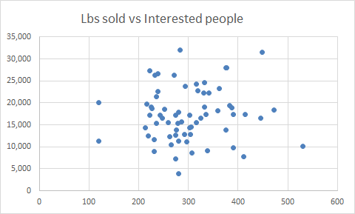
2 (b)
Co-relation coeff = 0.05221
Co-relation coeff is very small and close to zero. So there is no impact on sales by the visits

Slide 27
3. Promotion Analysis

Slide 28
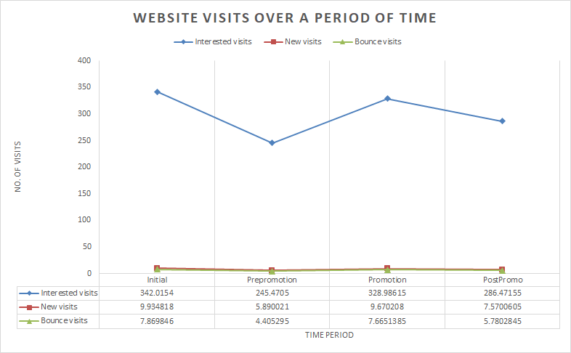
Website Model
Demographics of Referrals
(pie charts)
Total Visitors
New visitors over time
Geographical Demographics
(pie charts)
Table(based on weekly periodization)
Average time/Interest visits/Pageviews per visits/

Slide 29
Opportunities
Promotion
Opportunities

Slide 30
Opportunities
Demographics
Opportunities

Slide 31
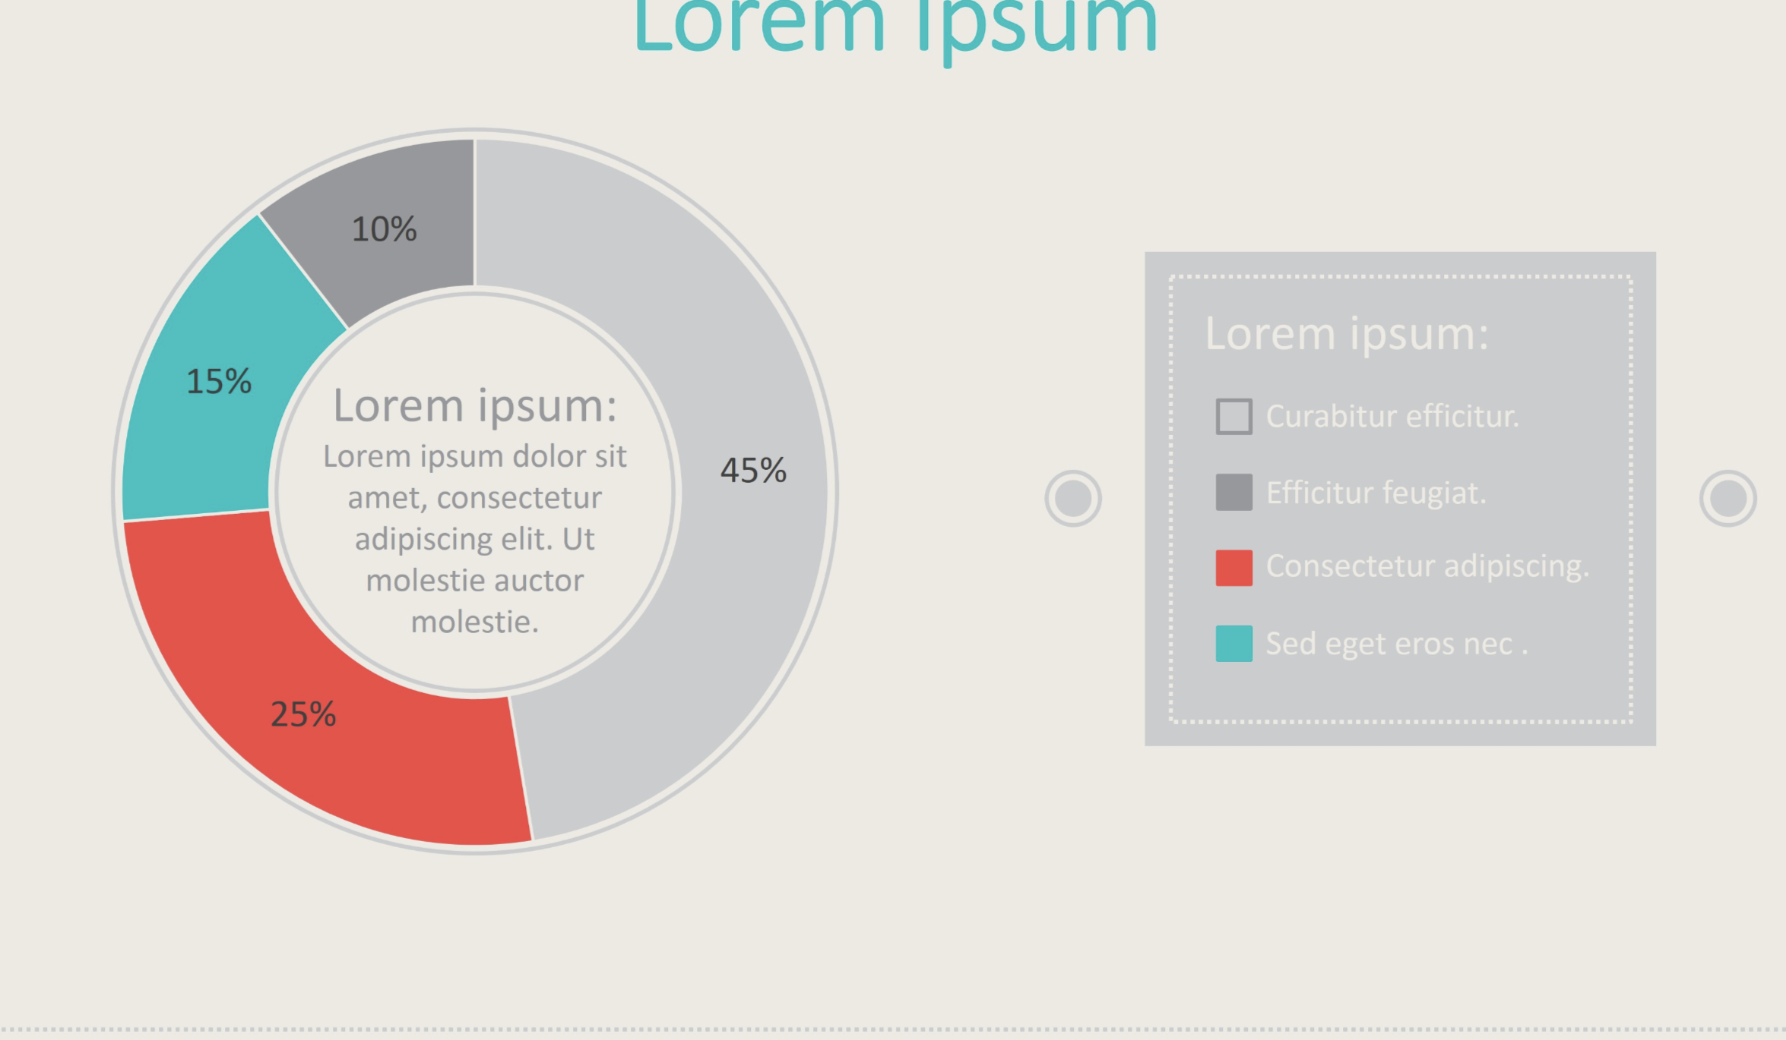
RGB:244,71,66
RGB: 0,192,193

